Slide 1
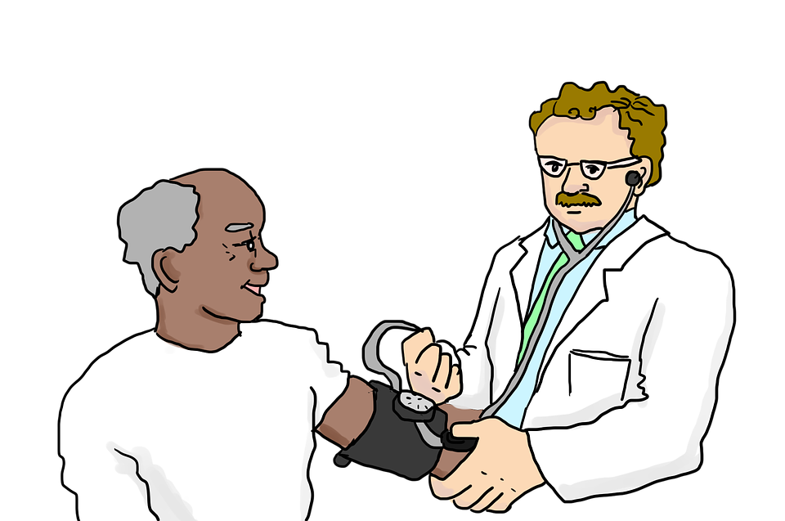
Try to guess what people might be saying or thinking in the following scene.
Image by LillyCantabile on Pixabay licensed by CC0

Slide 2
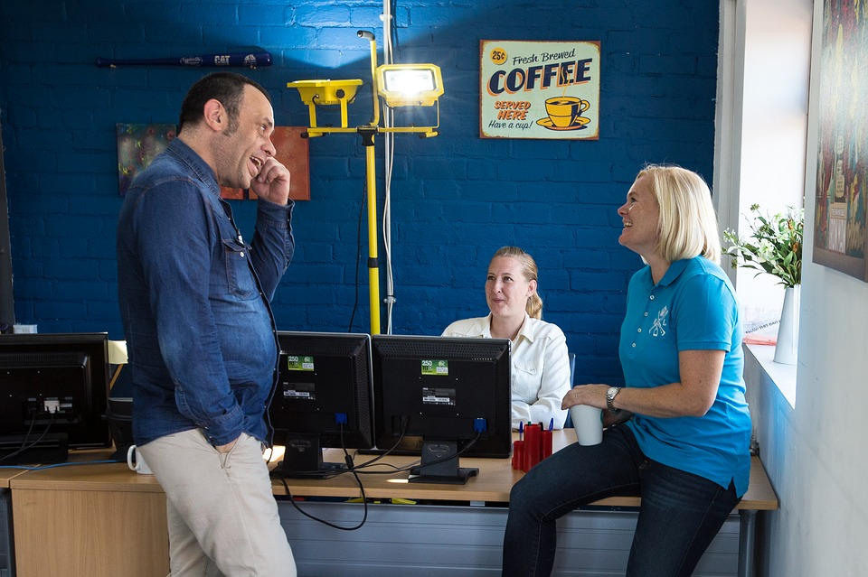
Try to guess what people might be saying or thinking in the following scene.
(Image by jamesoladujoye on Pixabay licensed by CC0)

Slide 3
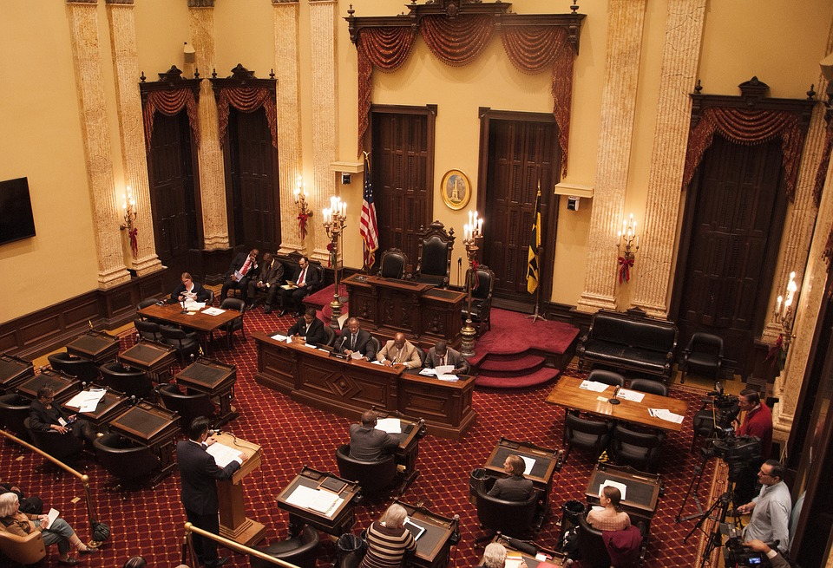
Try to guess what people might be saying or thinking in the following scene.
(Image by BruceEmmerling on Pixabay licensed by CC0)

Slide 4
Try to guess what people might be saying or thinking in the following scene.
(Image by sasint on Pixabay licensed by CC0)

Slide 5
Try to guess what people might be saying or thinking in the following scene.
(Image by rawpixel on Unsplash licensed by Unsplash)

Slide 6
Try to guess what people might be saying or thinking in the following scene.
(Image by rawpixel on Unsplash licensed by Unsplash)

